Slide 1



All about
YELLOW CLASS
(Year One)
Class Teacher:
Miss Corbishley
Teaching Assistants:
Miss Chadwick
Mrs Chowdhury

Slide 2
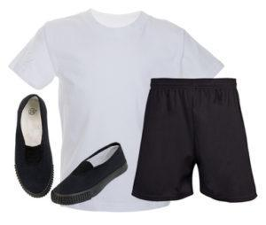
PE Days
Our PE days are Wednesday and Thursday. Please send children to school on this day wearing their full PE kit as well as their school jumper. As a reminder, school PE kit consists of:
White t-shirt or polo shirt
Black shorts, tracksuit / jogging bottoms or leggings
Trainers or pumps
Children will remain in their PE kit all day and will still play out at play-times so please dress appropriately and consider the weather on the day.
No football kits, hoodies, non-uniform jumpers or open-toed footwear please

Slide 3

Reading Books
Please can your child bring their book bag and reading book to school every day.
We will change their books when their journal has been signed 3 times.
This is to improve their confidence and fluency and help them to make accelerated progress.
Their reading book is carefully matched to their phonics ability. Please do not worry if your child finds their reading book easy - they are supposed to!
We request that you spend at least 10 minutes a day listening to your child read at home. This is essential to support their progress in all areas of their learning.

Slide 4
Homework and Library books
Homework will be given out each term. There will be a matrix full of tasks for your child to complete.
This may consist of paper homework or homework set via PING which will explain the tasks clearly.
Library books will be given out on a weekly basis and need to be returned each week.
Please check PING regularly.

Slide 5
This term our topics are:
English – Simple Sentence Work/Harry the Happy Mouse
Maths – Red Rose Maths
RWI – Phonics and Guided Reading
History –Changes within living memory Old and New Toys
Science – Human Body and the senses
Art – Artist Study (Andy Goldsworthy)
Religious Education – Harvest
Computing- Internet Safety and exploring Purple Mash

Slide 6
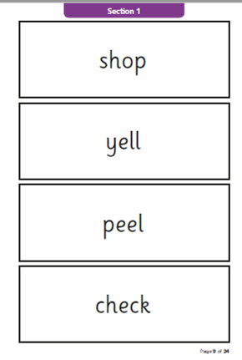
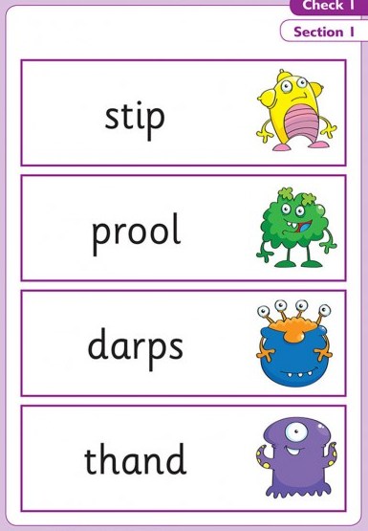
Phonics Screening Check
The phonics screening check is usually taken at the end of Year One.
The test consists of 40 words.
20 real words
20 nonsense words
https://www.gov.uk/government/publications/phonics-screening-check-sample-materials-and-training-video

Slide 7

Any
questions?

Slide 8
Useful websites
Purple mash – Same log in details
https://www.purplemash.com/sch/burnley-stp
BBC Bitesize - Challenge yourself in lots of literacy, maths or science activities.
https://www.bbc.co.uk/bitesize
School Website – Our class page is updated regularly.
https://www.st-peters-burnley.lancs.sch.uk/pink-class-4/

