Slide 1

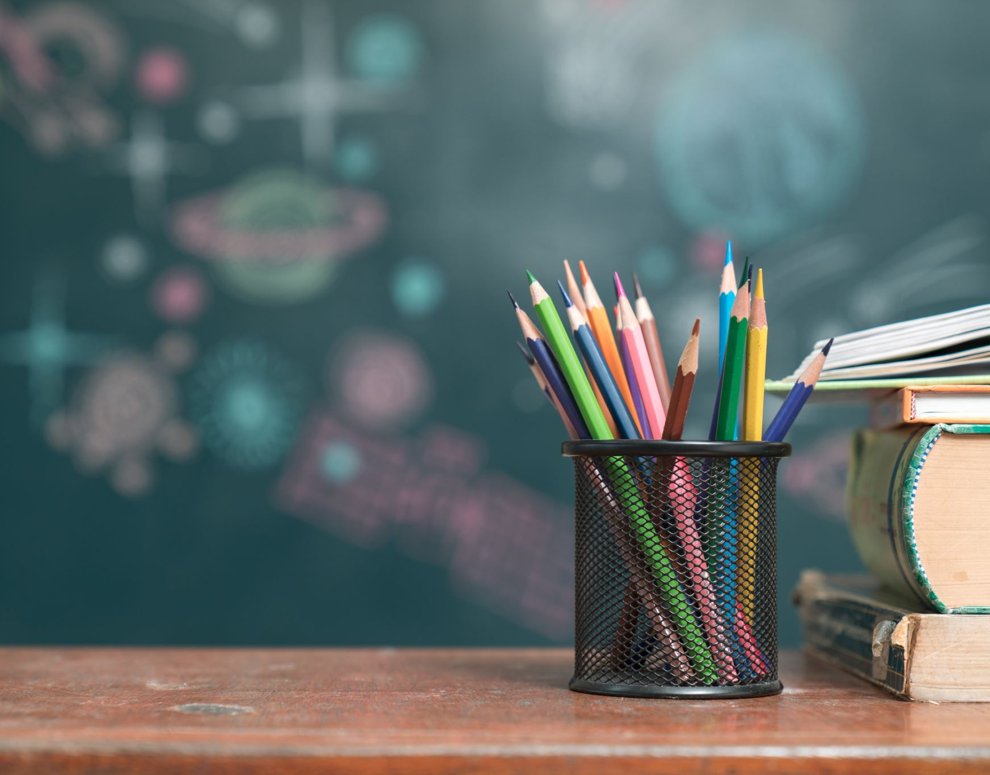

All about
Green Class
(Year Three)
Miss Brooks
Miss Chadwick

Slide 2
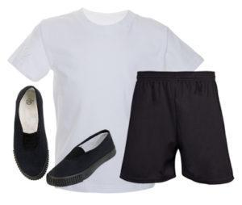
PE Days
Our PE days are Tuesdays and Wednesdays. Please send children to school on this day wearing their full PE kit as well as their school jumper. As a reminder, school PE kit consists of:
White t-shirt or polo shirt
Black shorts, tracksuit / jogging bottoms or leggings
Trainers or pumps
Children will remain in their PE kit all day and will still play out at play-times so please dress appropriately and consider the weather on the day.
No football kits, hoodies, non-uniform jumpers or open-toed footwear please

Slide 3

Reading Books
Please can your child bring their book bag and reading book to school every day.
This is to improve their confidence and fluency and help them to make faster progress.
Their reading book is carefully matched to their phonics ability. Please do not worry if your child finds their reading book easy - they are supposed to!
We request that you spend at least 10 minutes a day listening to your child read at home. This is essential to support their progress in all areas of their learning.

Slide 4
Useful websites
Teams - Log in details (same as last year)
Purple mash – Same log in details
https://www.purplemash.com/sch/burnley-stp
BBC Bitesize - Challenge yourself in lots of literacy, maths or science activities.
https://www.bbc.co.uk/bitesize
School Website – Our class page is updated regularly.

Slide 5
Homework
We would like to inform you that this academic year, our school will not be assigning traditional homework for children. Instead, we are placing a strong emphasis on two key areas that have a significant impact on children’s learning: daily reading and times tables practice.
We kindly ask that your child reads for at least 15–20 minutes every day at home. This can be done independently or with an adult. Regular reading not only strengthens vocabulary and comprehension but also helps foster a lifelong love of books. Younger children also love to listen to CBeebies bedtime stories https://www.bbc.co.uk/cbeebies/shows/bedtime-stories or listen to adults read to them. There are lots of free eBooks here https://home.oxfordowl.co.uk/reading/free-ebooks/. Also remember children can borrow library books from school and from Burnley library. Take a look at these top tips https://home.oxfordowl.co.uk/reading/reading-at-home/
In addition, we expect children to practise their times tables daily. A solid grasp of multiplication facts is essential for success in many areas of maths, and regular practice at home helps reinforce what is being taught in school.You might find apps like Times Tables Rock Stars,https://www.timestables.co.uk/ or Hit The Button https://www.topmarks.co.uk/maths-games/hit-the-button useful when practising, and use these songs https://www.percyparker.com/ to learn the times tables.

Slide 6

Any
questions?

